Slide 1

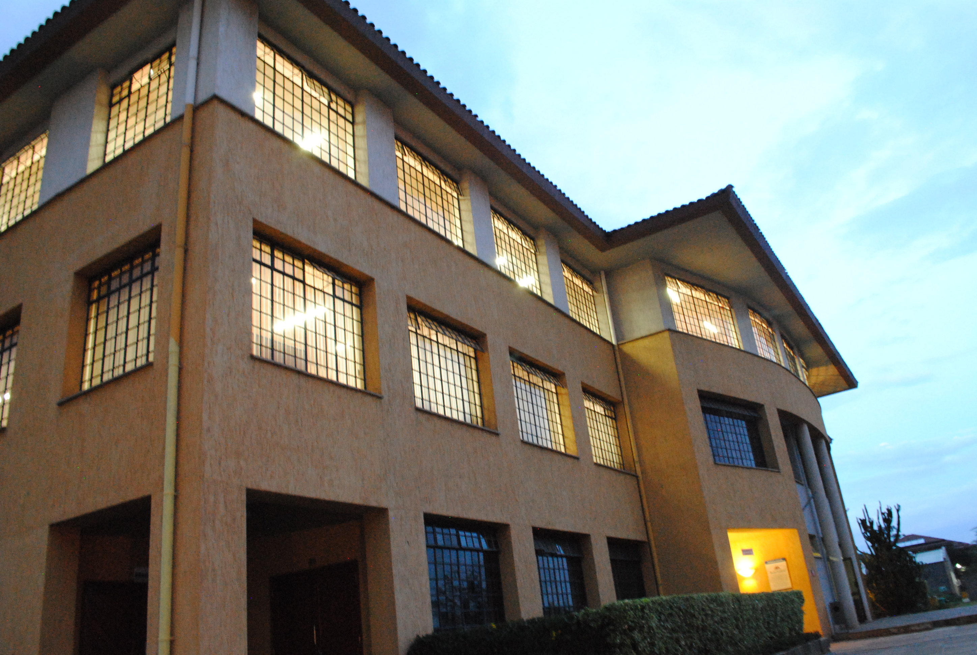

Making Moral Judgements
Principles of Ethics

Slide 2
Overview
The Triple Font of Morality Theory
The Principle of Double Effect
Practical wisdom in moral judgements

Slide 3
Learning Outcomes
Explain the Triple Font of Morality Theory [TFM]
Explain the Principle of Double Effect [PDE]
Apply the Triple Font of Morality Theory to specific cases [TFM]
Analyse cases using the Principle of Double Effect [PDE]
Discuss the role of practical wisdom in making moral judgements

Slide 4
Case: Giving in or giving up
Read the case individually
Identify the key ethical “issues”
Suggest a possible way forward for Anne
Take note for future reference
Individual activity [5 – 8 minutes]: read the case,
think and write one suggestion in the Zoom Chat

Slide 5
Case – Manipulative Manager
A manager who manipulates subordinates may obtain excellent immediate results but when those who were manipulated realize this they may act against him and refuse to cooperate in the future
How can we analyse the ethical dimension of the scenario?

Slide 6
The Triple Font of Morality [TFM]
The Triple Font of Morality is a framework for making moral judgements based on three elements present in any decision
Main action
The intention – end
The circumstances

Slide 7
Triple Font Theory of Morality
DECISION
1. ACTION
MEANS
2. INTENTION
GOAL
3. CIRCUMSTANCES
PREDICTABLE CONSEQUENCES
SITUATIONAL FACTORS -EXISTING CIRCUMSTANCES

Slide 8
1. Action – Object chosen
What act do you decide to carry out?
What is the ethical value of the act?
Morality of the action chosen as a means to the end
Distinguish:
Physical/material act
To shoot someone
Moral act
Murder
Killing in legitimate self-defence
Accident

Slide 9
2. Intention - End
What goal do you want to achieve?
What is the ethical value of the goal?
Morality of the intention/purpose which motivates the decision
Intrinsically linked to the action
Tell a lie to avoid punishment
Tell the truth to be honest

Slide 10
Towards overall morality (1)
Bad moral act
Good intention
Bad act
YOU DECIDE TO COMMIT FRAUD TO SAVE YOUR COMPANY FROM BANKRUPTCY

Slide 11
Towards overall morality (2)
Good moral act
Bad intention
Bad act
You invite a colleague out to dinner with the
intention of ‘stealing’ an interesting idea for a new product he has developed through the conversation and presenting it in your own name to the CEO.

Slide 12
Morally correct decision
Good moral act
Good intention
Good act
CAN YOU COME UP WITH AN
EXAMPLE? POST IN ZOOM CHAT
You realise that your elderly neighbour lives alone and
may have some needs as he cannot leave his home for health reasons. You go to visit him and offer to do his shopping so he has what he needs and does not need to go out.

Slide 13
Circumstances
Non-essential conditions which may modify the moral nature of an act
Foreseeable consequences
Negative, disproportionate, other consequences
Situational circumstances
A variety of situations surrounding the act which may have moral value

Slide 14
Situational circumstances
Quality / quantity of the object
5,000/ or 5 billion
Characteristics of acting person
Patricide
Place
Time
Means used
Manner
Violence
Secondary motives

Slide 15
Circumstances...
CAN
CANNOT
Increase / decrease the goodness or badness of the act
Make a good act become bad
Make a bad act become good!

Slide 16
Overall morality of Case
Decision
Act
Intention
Circumstances

Slide 17
Chart for ethical analysis
MORAL OBJECT - ACT | END / INTENTION | CIRCUMSTANCES
---------- | ---------- | ----- ------ -----
MORALITY IN TERMS OF AN ETHICAL PRINCIPLE | MORALITY IN TERMS OF AN ETHICAL PRINCIPLE | MORALITY IN TERMS OF AN ETHICAL PRINCIPLE
Bad – goes against their human dignity | Good – respects common good | Bad – against golden rule
OVERALL ETHICAL VALUE OF THE ACTION?

Slide 18
Case – Manipulative Manager
A manager who manipulates subordinates may obtain excellent immediate results but when those who were manipulated realize this they may act against him and refuse to cooperate in the future
Act + moral value [ethical principle]?
Intention + moral value [ethical principle]?
Circumstances + moral value [ethical principle]?
Overall moral value?

Slide 19
Morality of Case
MORAL OBJECT - ACT | END / INTENTION | CIRCUMSTANCES
Manipulation of employees | To get excellent results | Refusal to cooperate in future
MORALITY IN TERMS OF SOME ETHICAL PRINCIPLE | MORALITY IN TERMS OF SOME ETHICAL PRINCIPLE | MORALITY IN TERMS OF SOME ETHICAL PRINCIPLE
Bad – goes against their human dignity | Good – profit for the firm + employees: human dignity // common good | Bad – difficult to achieve good results in future: disrespect human dignity // golden rule
OVERALL ETHICAL VALUE OF MANAGER’S ACTION?

Slide 20
Breakout Rooms 7 to 12
Case – Giving in or Giving up
Read the case and identify:
A key action + it’s morality
Corresponding intention + it’s morality
Related circumstances + their morality
How would you advise Anne to act?
Give reasons for your answer

Slide 21
The Principle of Double Effect (PDE)
Many personal and professional actions simultaneously give rise to a good effect specifically intended as a goal, and a bad effect
Actions with a double effect
A factory manufactures a useful product, creates wealth and provides jobs (good effects), but pollutes the environment (bad effects)

Slide 22
The Principle of Double Effect
A good action, with a good intention which has a good effect and a possible bad secondary effect
The side effects may be foreseen but are not intended directly
Examples in the fields of tourism, hospitality, finance?
Think and share

Slide 23
Principle of Double Effect [complex actions]
GOOD ACTION Downsize number of employees to save firm
GOOD MAIN EFFECT Financial improvement of firm
BAD
INDIRECT EFFECT Employees with little education lose their jobs

Slide 24
Covid-19 Scenario
Due to the government restrictions on movement during the coronavirus, you and your spouse are working from home; the 3 kids [ages 2-10] are also at home. Your family lives in a small apartment. For the last 10 weeks you and your spouse have been struggling to cook, wash clothes, clean the house, manage the kids and keep up with your online work. You are both exhausted and behind with your work deadlines. You are thinking of recalling your house-help, whom you sent home at the start of the shut-down. She lives in a Covid-19 affected area. As your house is small, she would have to come and go each day with the risk of bringing the virus to your home. You are in a dilemma about how to act.

Slide 25
CHART TO ANALYSE ACTS WITH DOUBLE EFFECTS
MAIN ACTION + INTENTION | MAIN EFFECT | INDIRECT EFFECT

Slide 26
CHART TO ANALYSE ACTS WITH DOUBLE EFFECTS
MAIN ACTION + INTENTION | MAIN EFFECT | INDIRECT EFFECT
Main Action: recall house-help Intention: help with the work | Ease stress of work in home | Possibility of exposing family to corona through the house-help
Morally good or bad? Ethical Principles | Morally good or bad? Ethical Principles | Morally good or bad? Ethical Principles

Slide 27
CHART TO ANALYSE ACTS WITH DOUBLE EFFECTS
MAIN ACTION + INTENTION | MAIN EFFECT | INDIRECT EFFECT
Main Action: recall house-help Intention: help with the work | Ease stress of work in home | Possibility of exposing family to corona through the house-help
Morally good or bad? Ethical Principles | Morally good or bad? Ethical Principles | Morally good or bad? Ethical Principles
Good? Principle/s? Person? Dignity? Common good? NML? | Good? Principle/s? | Bad? Principle/s?

Slide 28
Can we carry out this good action?
Good action
Good main effect
Bad indirect effect
In principle, we should not carry out such an act
Acting in a way you know will bring something bad
along with something good

Slide 29
Conditions for an action with double effect to be morally acceptable
The action (moral object) should be morally good
The intention of the acting person should be morally good
The good main effect should follow immediately on the good action
4. A proportionately serious reason should exist, to justify the bad indirect effect
5. Effort to reduce the negative impact of indirect effect

Slide 30
Proportionately serious reason
The importance of carrying out the good action with good direct effect should be greater than the importance, seriousness of the bad effect
Good action and good effect
Bad indirect effect

Slide 31
Breakout Rooms 7 to 12
Case – Giving in or Giving up
Read the case and identify:
A key action + it’s morality
Corresponding intention + it’s morality
Related circumstances + their morality
How would you advise Anne to act?
Give reasons for your answer

Slide 32
Breakout Rooms 1 to 6 Case – CEO Remuneration
Analyse the Case using the Principle of Double Effect and applying the conditions for moral acceptability
Prepare for class discussion
Main act; direct effect; indirect effect; intention; proportionate reason; reduction of any negative impact
15 minutes

Slide 33
Conclusion
Need for reflection on the ethical dimension when making decisions
Practice applying ethical principles to ensure that moral judgements are wise
Use ethical frameworks when analysing decisions

Slide 34
Conclusion
Think before you act
Moral object
End / intention
Circumstances
Acts with double effect
To ensure you act in the best way possible

Slide 35
THE DECISION-MAKING PROCESS
Formulation of the problem
Identify a decision you
made recently or you will
make soon
Setting and evaluation of the goal
Generation of alternatives
DELIBERATION
Evaluative criteria
Evaluation of alternatives
ELECTION of one alternative
IMPLEMENTATION
Evaluation of the outcomes

Slide 36
Personal moral judgements
We need to make moral judgements within any decision-making process
Judgements of conscience:
an act of the intellect that judges
‘this act is bad – do not do it’ or
‘this act is good – do it’
Need for practical rationality

Slide 37
Practical Rationality
The intellectual discernment between good and evil which permits us to make moral judgements
Enables us to formulate moral judgements about particular situations
Requires ethical knowledge and practical wisdom

Slide 38
Practical Wisdom -Prudence
Reinforces practical rationality by helping to understand a decision and the consequences before finalising the decision
Helps to balance various criteria for moral judgements and to determine the best alternative
Ensures moral judgements are sound and indicate the best way to act

Slide 39
7 Step Process for wise decision-making
2 minutes personal reflection to apply these
steps to a decision you made or need to make
1. DELIBERATION | On the particular situation, pondering relevant circumstances and foreseeable consequences
2. SINCERE ATTITUDE | Seeking what is good, avoiding false rationalizations to justify one’s interests
3. ETHICAL PRINCIPLES | Such as the Golden Rule and other ethical principles (Personalist, the Common Good, etc.)
4. ETHICAL TRAINING | In topics related to one’s own field

Slide 40
Practical wisdom in making sound moral judgements
2 minutes personal reflection to apply these
steps to a decision you made or need to make
5. RECALLING | Previous similar situations and criteria acquired from them
6. SEEKING ADVICE | From competent people of proven moral worth - integrity
7. SAFER JUDGMENT | If doubt persists, lean toward a safer judgement

Slide 41
Individual Reflection
Go back to the decision you identified earlier
Apply the 7-step process to discover the best decision

